Slide 1
Lesk’s Algorithm: A simple method for word-sense disambiguation, Supervised Algorithms
-Aishwarya Londhe

Slide 2
Perhaps one of the earliest and still most commonly used methods for word-sense disambiguation today is Lesk’s Algorithm, proposed by Michael E. Lesk in 1986.
Lesk’s algorithm is based on the idea that words that appear together in text are related somehow, and that the relationship and corresponding context of the words can be extracted through the definitions of the words of interest as well as the other words used around it.
Developed long before the advent of modern technology, Lesk’s algorithm aims to disambiguate the meaning of words of interest — usually appearing within a short phrase or sentence — by finding the pair of matching dictionary “senses” (i.e. synonyms) with the greatest word overlap in dictionary definitions.

Slide 3
In the example Lesk uses, the references the words “pine” and “cone”, noting that the words return the following definitions from the Oxford English Dictionary:

Slide 4
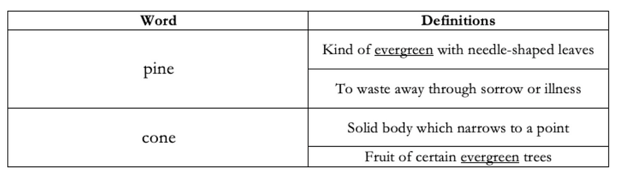

Slide 5
In the simplest terms, Lesk’s algorithm counts the number of overlaps between all dictionary definitions of a word of interest and all dictionary definitions of the words surrounding it, known as a “context window”.
Then, it takes the definition corresponding to the word with the highest number of overlaps, without including stop words (words such as “the”, “a”, “and”), and infers it to be the word’s “sense”.
If we consider “pine” to be the word of interest, and “cone” to be the only word in its context window, comparing dictionary definitions of “pine” and “cone” would find that “evergreen” is the most common “sense” to both terms.
Thus, we can logically infer that the word of interest “pine” refers to an evergreen tree, rather its alternate definition.

Slide 6
Advantages and Disadvantages
There are numerous advantages to Lesk’s algorithm, the primary being that its simplicity makes it easy to implement, applicable in a variety of different contexts, and thus easily generalizable.
Lesk notes that the algorithm does not depend on global information, meaning that since the same word could be referenced many times throughout a text but change each time, the meaning of a word is only derived from the collection of immediate supporting words in its context window, rather than from the entire text itself.
In addition, Lesk’s algorithm is non-syntactic, meaning that the approach does not depend on the arrangement of words or structure of a sentence, since all associations are made by dictionary-definition only.

Slide 7
This makes the algorithm a good approach to use in tandem to syntax based text analytics solutions.
For instance, a part-of-speech based text tagger might be able to identify the use of “mole” as a noun, but would fail at accurately differentiating between the animal (mole), the skin growth (mole), and the unit of measurement (mole), since all three are nouns.
In cases such as this, the benefits of Lesk’s algorithm shines through.

Slide 8
Despite its simplicity and power, the biggest drawback to Lesk’s original algorithm is its performance — its accuracy was proposed by Lesk to be only around 50–70%, and has been shown to be much lower when experimentally validated against sense-tagged texts
Lesk leaves several questions unanswered.
This includes what dictionary is best used, if all matched terms should be considered equally or weighed by the length of the dictionary definition itself, and how wide the context window of words should be (Lesk proposes around 10 words but suggests that it is quite flexible).

Slide 9
Applying Lesk’s Algorithm in Python
The following is a simple example of how Lesk’s algorithm can be implemented, using the pywsd package for word-sense disambiguation in Python.
The following function was developed as an implementation of the Adapted Lesk algorithm described by Banerjee & Pederson in 2002, which uses the WordNet implementation of Lesk.

Slide 10
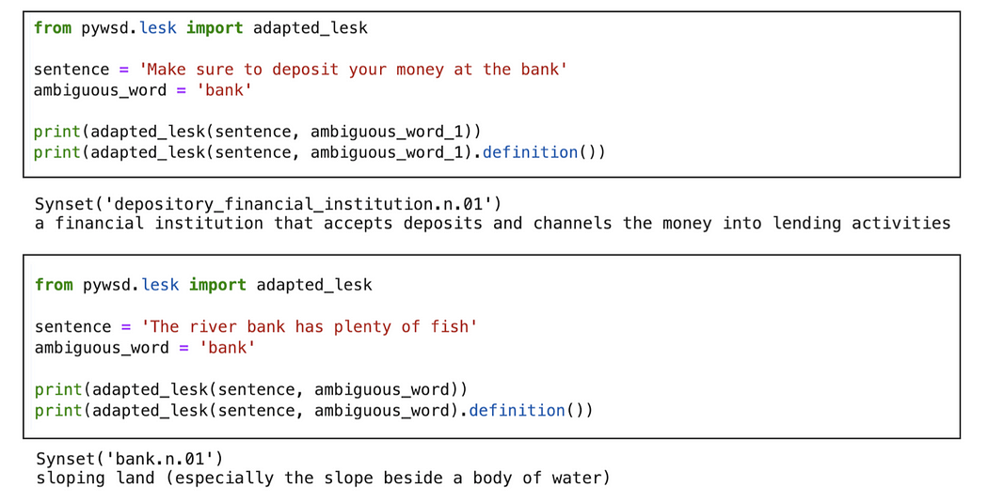
Example of the Adapted Lesk’s Algorithm implemented in Python

Slide 11
We can see here that given the word “bank”, Lesk’s algorithm is able to infer that when used in context, one sense of bank refers to the financial institution, while the other refers to a type of sloping land.
Again, when making such associations, the syntactical structure does not matter, rather, the success of Lesk’s algorithm depends on the availability of contextual cues, such as “river” and “fish”, when referring to a river bank, and “deposit” and “money” when referring to a financial bank.

Slide 12
Naive Bayesian (NB) classifier
A naive Bayesian (NB) classifier is a probabilistic classifier that uses Bayes' theorem to make predictions about unknown classes.
It's a supervised learning algorithm that's considered optimal when there's no dependency between features and other features given a class.
NB classifiers are often used in text classification, spam filtering, recommender systems, and sentiment analysis.

Slide 13
NB classifiers make predictions by applying two assumptions to Bayes’ theorem:
Independence: Each possible pair of features is independent of each other
Equal contribution: All features contribute equally to the outcome

Slide 14
NB classifiers are simple and efficient to train, and they require relatively few training samples.
They're also highly scalable, with the number of parameters required being linear in the number of variables in a learning problem.
However, if the assumption of independence isn't true in practice, the classifier's performance can degrade.

Slide 15
Decision list
A decision list can be a tool or method for making decisions, such as a decision matrix, decision tree, or intuitive decision model:
Decision matrix
A tool that helps evaluate and prioritize a list of options.
To use a decision matrix, you first create a list of weighted criteria, then assess each option against those criteria.
The options are listed as rows in a table, and the factors are listed as columns.
You can use a decision matrix to quickly address the pros and cons of each option, weigh different variables, and make a decision.

Slide 16
Decision tree
A tool that represents a series of decisions, the alternatives to those choices, and the resulting payoffs or probabilities.
Decision trees can present all decision alternatives first, followed by all states of nature, or vice versa.

Slide 17
Intuitive decision model
A simple decision-making model that involves using your intuition or "gut feeling" to make a decision.
This model is best for straightforward decisions that don't require much analysis

Slide 18
Other types of decisions include:
Operational decisions
- Everyday business decisions made by employees, such as product inventory, customer orders, or departmental organization
Career planning
- Decisions made in the work field, such as before taking a job, changing careers, or getting more education or training

Slide 19
Decision List models identify subgroups or segments that show a higher or lower likelihood of a binary (yes or no) outcome relative to the overall sample.
For example, you might look for customers who are least likely to churn or most likely to say yes to a particular offer or campaign

